Slide 1

Digital Solutions
IA1 – Technical Proposal
Riley Hampson

Slide 2

Climate Facts
Technical Proposal
A Web Application

Slide 3
Contents
Task Information:
Task Breakdown (Mind Map)
Constraints
Criteria
Technical Proposal:
Introduction
User Story (& Existing Solutions)
Data Story (& Datasets & Data Dictionary)
Proposed Solution
Conclusion

Slide 4
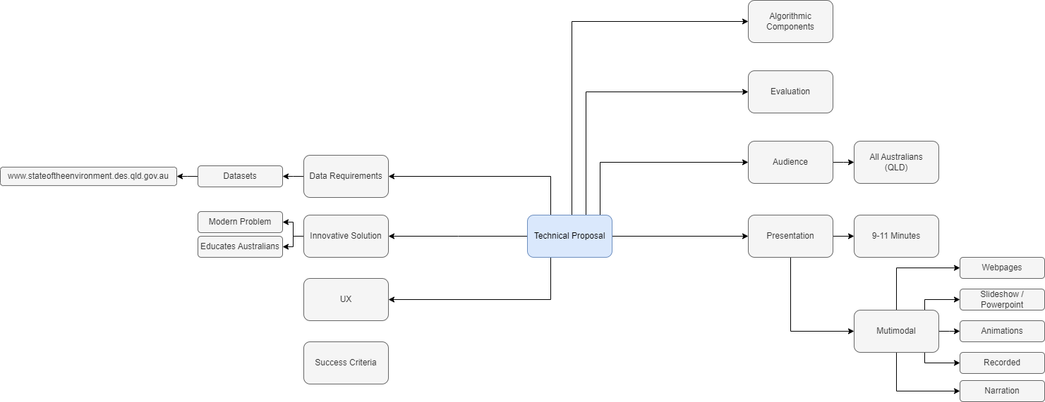
Task Breakdown

Slide 5
Constraints
Time – The technical proposal must be completed for the QLD Department of Environment and Science by the 26th of February 2024 at 8:30 am
Data – The data must be sourced from the QLD Department of Environment and Science page: (www.stateoftheenvironment.des.qld.gov.au). Users must be able to upload their Greenhouse Gas Emissions data for analysis.
Legal – any resources used throughout this document, the technical proposal and the proposed solutions must be publicly accessible under Creative Commons 4.0

Slide 6
Criteria
Prescribed
By Monday, the 26th of February 2024 at 8:30 am:
Develop a low-fidelity prototype of a responsive web application
Users can upload greenhouse gas data to be analysed
Gas emissions to be compared between states for 2018
Present accurate, relevant data in an easily accessible manner
Self-Determined
By Monday, the 26th of February 2024 at 8:30 am:
Create a good UI with appropriate accessibility features to ensure accessibility and a good UX
Create effective and efficient Algorithms by using selection and iteration
Allow Climate data to be uploaded in .csv file format
Develop a prototype of a normalised 3NF database with accurate and appropriate Primary and Foreign key Relationships

Slide 7

Introduction
“Avoid, minimise or mitigate impacts to the environment.”
The State of Queensland. (2017). State of the Environment (Department of Environment and Science). Qld.gov.au. https://www.stateoftheenvironment.des.qld.gov.au/

Slide 8
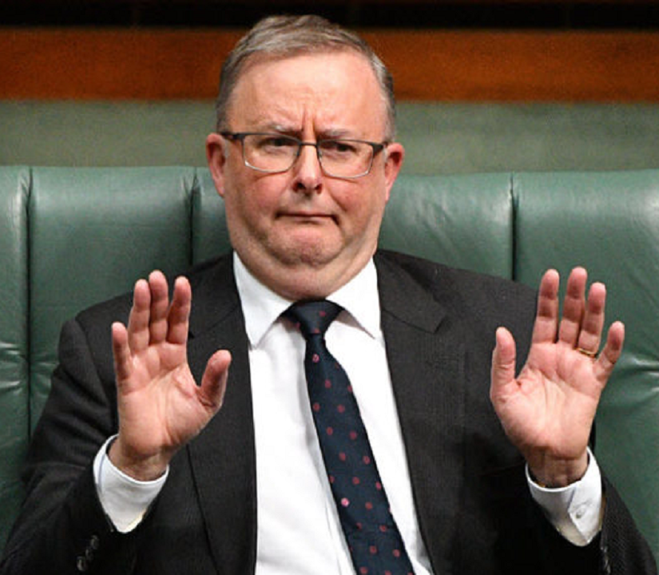
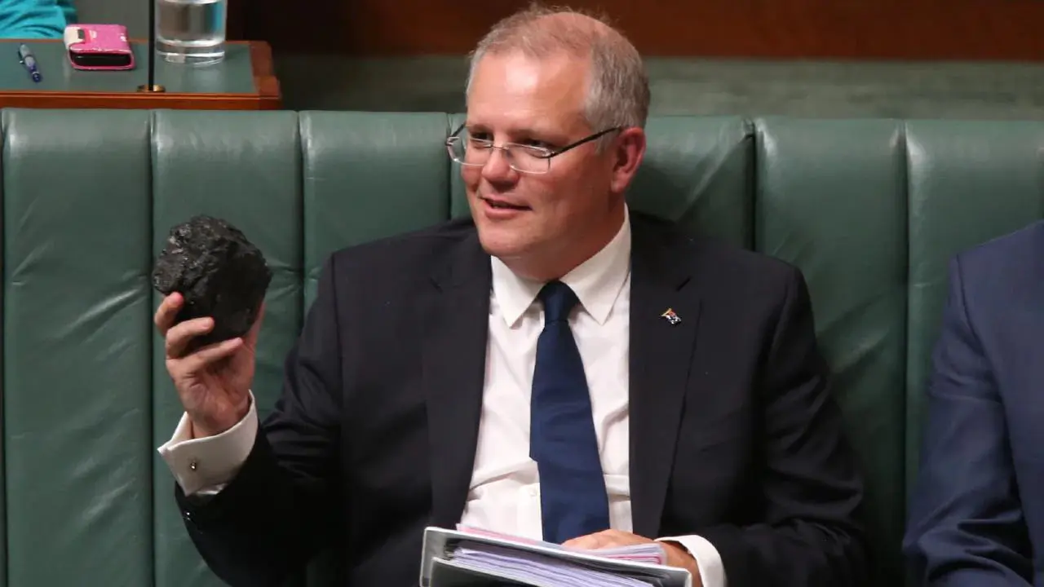
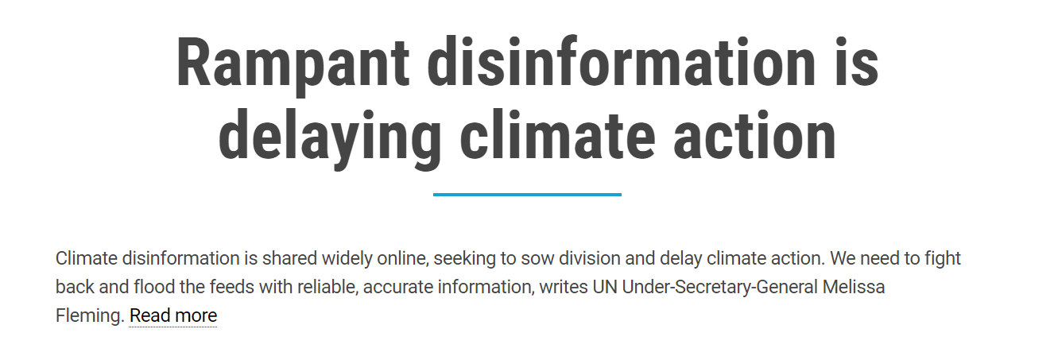
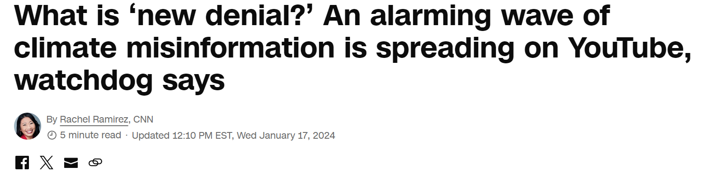
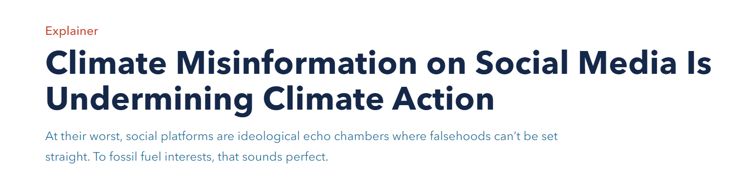
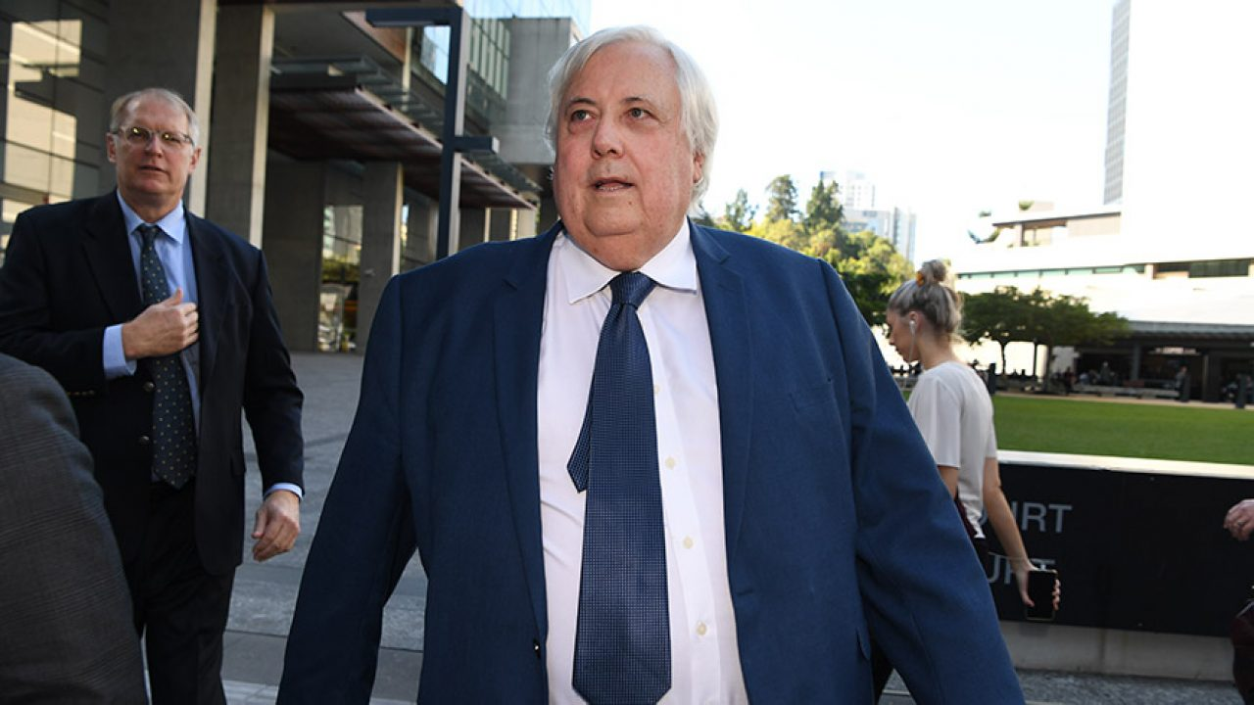
Misinformation

Slide 9

User Story

Slide 10
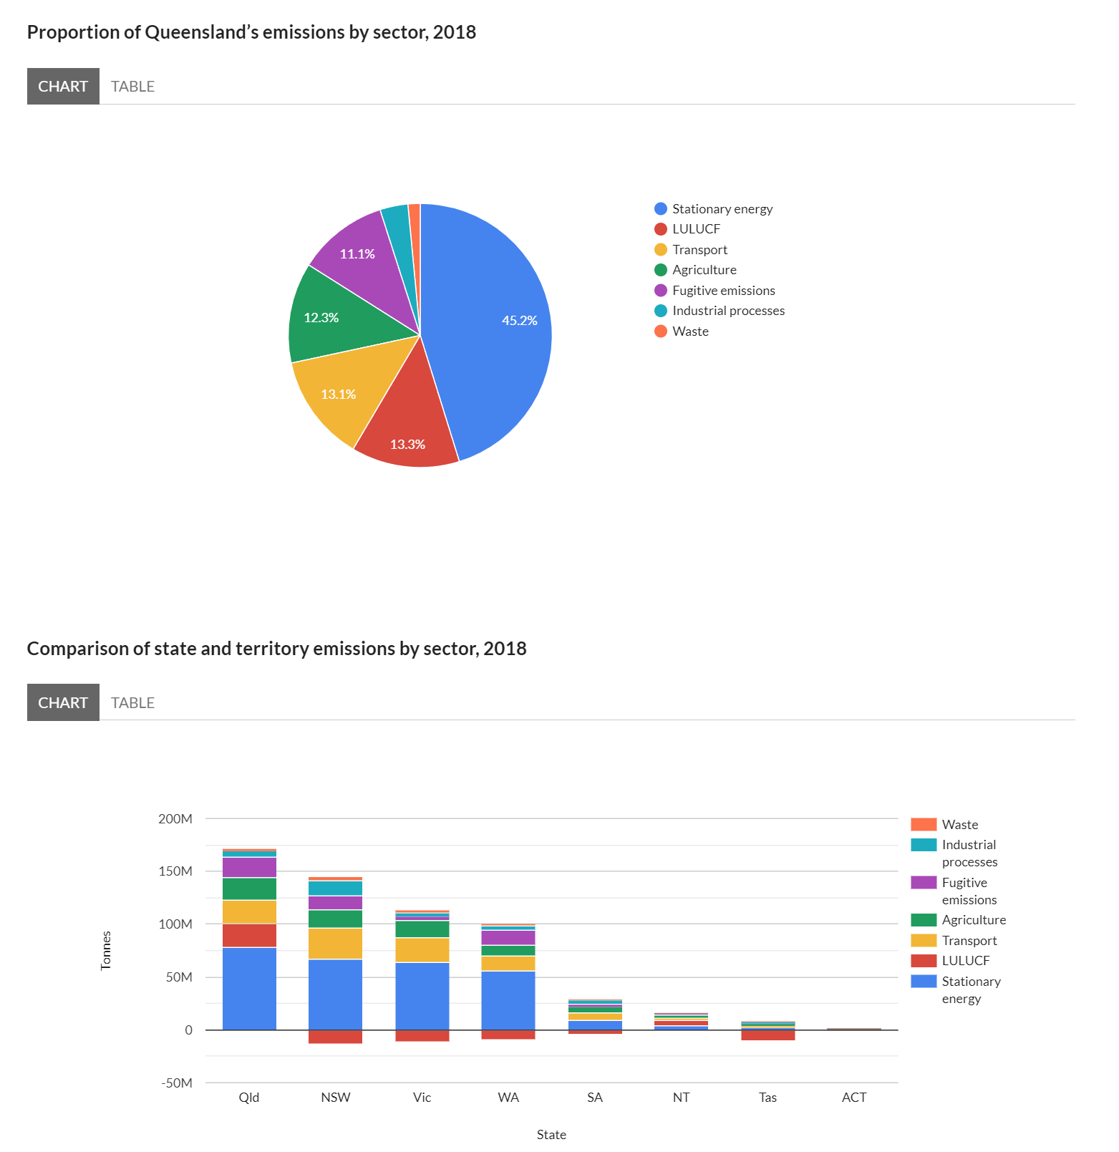
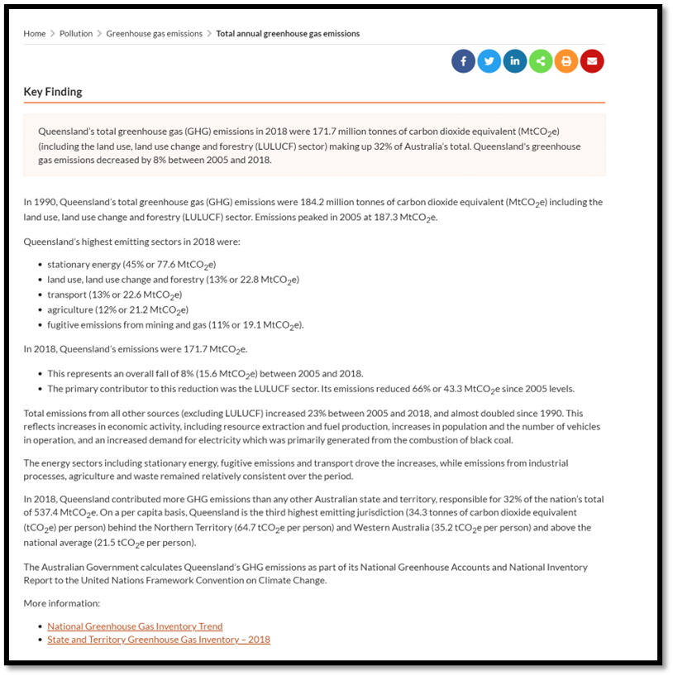
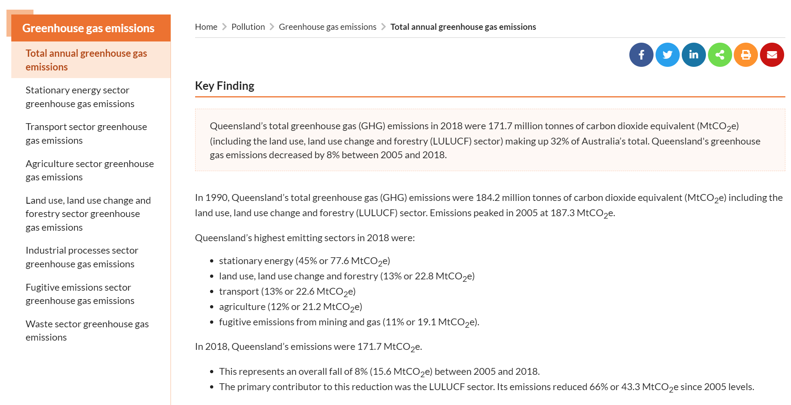
Existing Solution

Slide 11
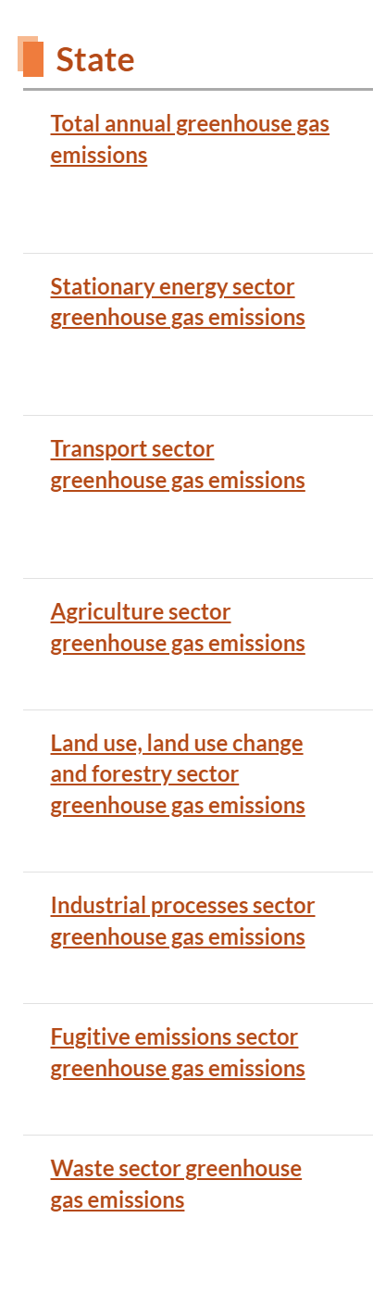
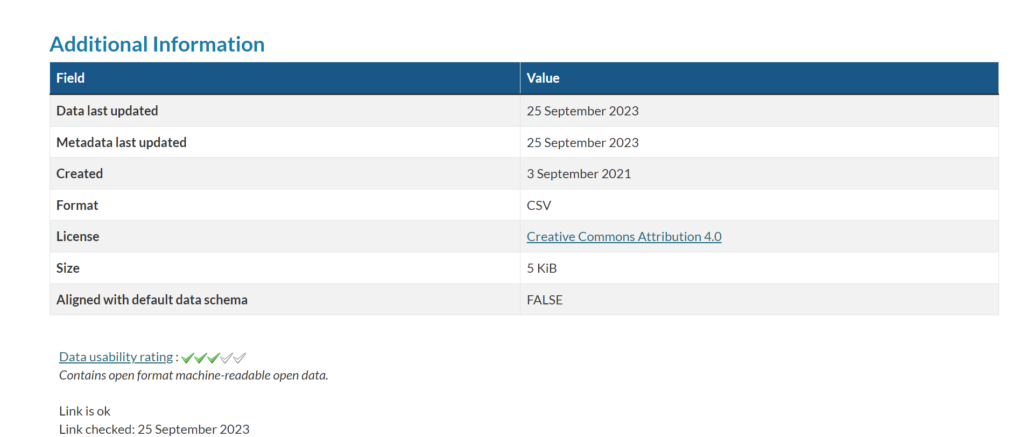
Data Story

Slide 12
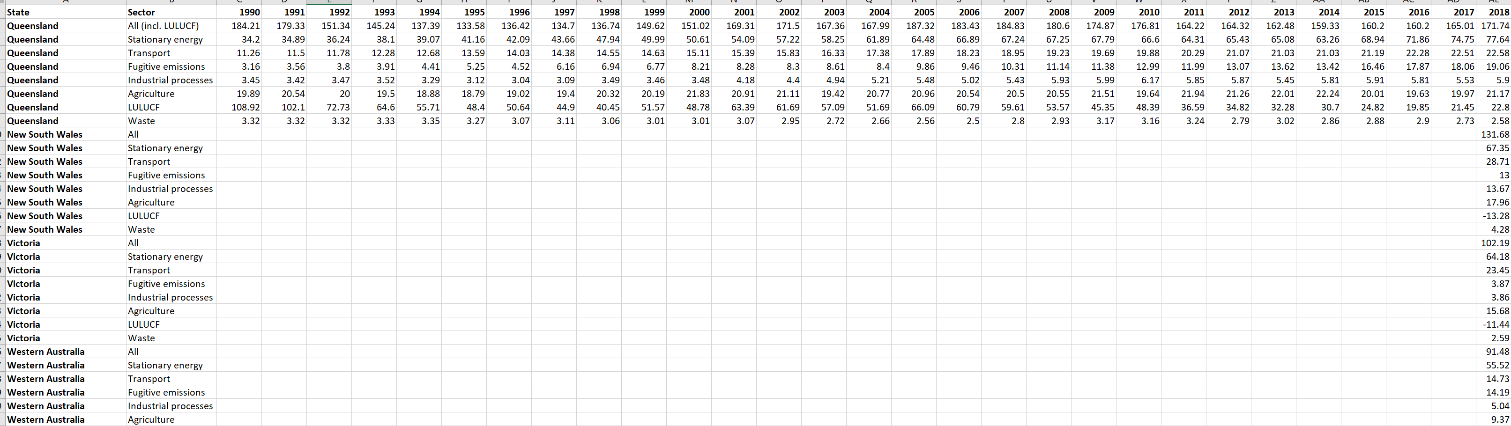
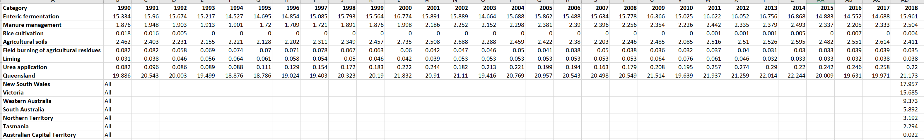
Datasets
Sector Totals:
Agriculture Totals:

Slide 13
Data Dictionary
Table: Emissions
Table: Sectors
Field | Data Type | Validation Rules | Example
Emission | Float(10) | Not Null | 15.5
Year | Int(4) | Not Null | 2018
State | Varchar(3) | Not Null | QLD
SectorID | Int(3) | Foreign key, Not Null | 1
SubsectorID | Int(5) | Foreign key, Not Null | 3
Field | Data Type | Validation Rules | Example
SectorID | Int(3) | Primary key, AUTO_INCREMENT | 1
Sector | Varchar(100) | Not Null | Agriculture
Table: Subsectors
Field | Data Type | Validation Rules | Example
SubsectorID | Int(5) | Primary key, AITO_INCREMENT, | 1
Subsector | Varchar(100) | Not Null | Agriculture

Slide 14
Sample data
Table: Emissions
Table: Sectors
Emission (Million Tons) | Year | State | Sector | Subsector
0.082 | 1990 | QLD | 1 | 2
0.039 | 2001 | QLD | 1 | 3
67.35 | 2018 | NSW | 2 | 1
14.73 | 2018 | WA | 3 | 1
SectorID | Sector
1 | Agriculture
2 | Stationary Energy
3 | Transport
Table: Subsectors
SubsectorID | Subsector
1 | Total
2 | Liming
3 | Urea Application

Slide 15
Proposed Solution

Slide 16
Wireframes
Climate Facts
Clear text establishes the website. Large text used to establish hierarchy.
Easy to access navigation bar located where most nav bar’s are for easy learnability
(Nav Bar)
Simple and noncomplex overall UI for easy retrieval of any presented information
Colour Contrast and Clear borders used to form hierarchy and split content based on relevance and importance
Charts placed at top of page so visual data is easy to find

Slide 17
Wireframes
Climate Facts
Simple and user friendly form layout with clear instructions
Large SubTitle ensures user is on correct page
(Nav Bar)
Data Upload
(Upload link)
Use of colour contrast to draw attention to an action button
File upload link will only allow .csv files for data integrity
Submit

Slide 18
(More Wireframe)

Slide 19
Algorithms
(Algo goes here)

Slide 20
Prototype

Slide 21
Climate Facts
HOME | UPLOAD | EMISSIONS BY SECTOR | STATE TOTALS

Slide 22
More Mockups here

Slide 23
Conclusion

Slide 24
Evaluation
Personal – Climate change affects everyone, displaying information in an easy-to-read and accessible manner allows people of all ages to be informed with correct statistics preventing misinformation.
Social – People will be able to take correct climate data and interpret it as they see fit, informing the community against misinformation.
Economic – Anyone with a device and an internet connection can access Climate Facts. There is limited economic impact, as the application will be state-hosted utilising data they are already funded to collect. There will be minimal costs such as administration and server hosting.

Slide 25
Evaluation
Prescribed:
All prescribed criteria were completed. A low-fidelity prototype of a responsive and interactive web application was developed. This application allowed users to upload their greenhouse gas data as required. The application allowed for easy viewing of gas emission totals between states for 2018. All of this was accomplished whilst presenting all relevant data in an easily accessible manner.
Self-Determined:
All self-determined criteria were completed. A prototype normalised 3NF relational database was developed with appropriate Primary and Foreign Key relationships. This allowed for climate data to be uploaded in the .csv file format. Effective and efficient Algorithms were developed to retrieve correct data for users. All of this was completed, allowing the development of a good UI that contains accessibility features to allow people of all ages easy access to the data, ensuring a good User Experience.

Slide 26
Recommendations

Slide 27
References

